Slide 1

FILEPRINTS:
IDENTIFYING FILE TYPES BY N-GRAM ANALYSIS
AUTHORS: WEI-JEN LI, KE WANG, SALVATORE J STOLFO AND BENJAMIN HERZOG
PRESENTED BY DIPTI KOTHARI
Content Detection and Analysis for Big Data
Notes:
Slides can vary as per your presentation, but header and footer should be consistent

Slide 2
WHY IDENTIFY FILE TYPES
BACKGROUND
MAGIC NUMBER
RELATED WORK
AIM
DATA
PROCESS
ONE CENTROID MODEL
MAHALANOBIS DISTANCE
MODELING AND TESTING
TRUNCATION
RESULTS
CONCLUSION AND FUTURE SCOPE
PROS AND CONS
3
4
6
7
8
9
10
11
12
13
16
18
19
20
CONTENT
OUTLINE
Content Detection and Analysis for Big Data
Notes:
Slides can vary as per your presentation, but header and footer should be consistent

Slide 3
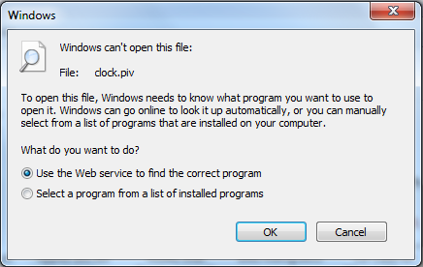
WHY IDENTIFY FILE TYPES
OS LEVEL FILETYPE DETECTION
Content Detection and Analysis for Big Data
Notes:
Slides can vary as per your presentation, but header and footer should be consistent

Slide 4

BACKGROUND
NORMALIZED BFD
BYTE 1=70/70,
BYTE 2=50/70 …… BYTE 255=3/70
FILEPRINTS:
INTRODUCED BY MCDANIEL AND HEYDARI
COMPUTE 1-GRAM FREQUENCY (BFD)
BYTE 1=70,
BYTE 2=50 …… BYTE 255=3
COMPUTE FILEPRINT, WHICH IS AVERAGE BFD
BYTE 1=(0.1+0.7+0.2+0.5)/4,
BYTE 2=(0.3+0.4+0.1+0.6)/4 ……
Content Detection and Analysis for Big Data
Notes:
Slides can vary as per your presentation, but header and footer should be consistent

Slide 5
DRAWBACKS
RESULTS
ONE MODEL FOR EACH FILE TYPE
28%
BACKGROUND
46%
TRAINED USING 4 FILES
FOR EACH FILE TYPES
96%
MODEL INVARIANT OF FILE SIZE
Content Detection and Analysis for Big Data
Notes:
Slides can vary as per your presentation, but header and footer should be consistent

Slide 6
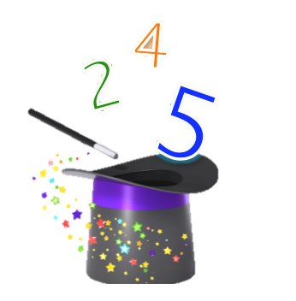
ISSUES
MAGIC NUMBER
MISSING MAGIC NUMBER
BEGINNING OF FILE IS DAMAGED
FRAGMENTED HEADER
PDF File
25 50 44 46
Content Detection and Analysis for Big Data
Notes:
Slides can vary as per your presentation, but header and footer should be consistent

Slide 7
RELATED WORK
ZERO DAY WORM DETECTION
TRAINING DATA IS NORMAL DATA ie. PDF,IMAGE ETC
NETWORK TRAFFIC FLOW
MALICIOUS EMAIL FILTER PROJECT
TRAINING DATA IS KNOWN MALICIOUS CODE
Content Detection and Analysis for Big Data
Notes:
Slides can vary as per your presentation, but header and footer should be consistent

Slide 8
GIVEN THE FILE TYPE OF A FILE, IDENTIFY ITS TRUE FILE TYPE
DETERMINE THE FILE TYPE OF AN UNNAMED FILE
AIM
Content Detection and Analysis for Big Data
Notes:
Slides can vary as per your presentation, but header and footer should be consistent

Slide 9
DATA
DATA CHARACTERISTICS
DATA BREAKDOWN
DATA
USAGE
800 FILES
20% TEST DATA
OF 8 TYPES
EXE,DLL,GIF,JPG,PDF,PPT,DOC,XLS
SIZE FROM
10KB TO
1MB
COLLECTED FROM THE INTERNET i.e. GOOGLE
80% TRAINING DATA
MS OFFICE FILES HAVE SAME HEADER
EXE AND DLL SAME HEADER
Content Detection and Analysis for Big Data
Notes:
Slides can vary as per your presentation, but header and footer should be consistent

Slide 10
PROCESS
ONE CENTROID MODEL
TRAINING DATA FOR MODEL GENERATION
RAW DATA
NORMALIZED BFD
SIMILARITY MEASURE
ASSIGN FILETYPE
TEST DATA
Content Detection and Analysis for Big Data
Notes:
Slides can vary as per your presentation, but header and footer should be consistent

Slide 11
ONE CENTROID
MODEL
NORMALIZED BFD
BYTE 1=70/1000,
BYTE 2=50/1000 ……
COMPUTE 1-GRAM FREQUENCY (BFD)
BYTE 1=70,
BYTE 2=50 …… BYTE 255=3
COMPUTE FILEPRINT, WHICH IS AVERAGE BFD & STD DEV.
BYTE 1=(0.01+0.27+0.32 …)/100,
BYTE 2=(0.13+0.42+0.1…)/100 ……
Content Detection and Analysis for Big Data
Notes:
Slides can vary as per your presentation, but header and footer should be consistent

Slide 12

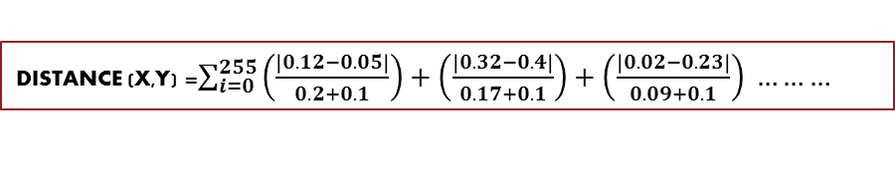

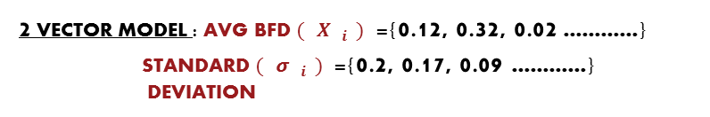
MAHALANOBIS DISTANCE
DISTANCE (X,Y) = $\sum_{\begin{aligned} \\ i=0\end{aligned}}^{\begin{aligned}n−1 \\ \end{aligned}}{\frac{\left|X_{i}−Y_{i}\right|}{(σ_{i}+α)}}$
X FEATURE VECTOR OF NEW OBSERVATION
Y AVG FEATURE VECTOR FROM TRAINING DATA
𝞼 STANDARD DEVIATION
𝞪 SMOOTHING FACTOR
ASSUMPTION: EACH BYTE VALUE IS INDEPENDENT HENCE COVARIANCE IS ZERO
2 VECTOR MODEL : AVG BFD ${(X}_{i})$={0.12, 0.32, 0.02 …………}
STANDARD ${(σ}_{i})$={0.2, 0.17, 0.09 …………} DEVIATION
TEST POINT: BFD ${(Y}_{i})$={0.05, 0.4, 0.23 …………}
DISTANCE (X,Y) =$\sum_{i=0}^{255}{\left(\frac{\left|0.12−0.05\right|}{0.2+0.1}\right)+\left(\frac{\left|0.32−0.4\right|}{0.17+0.1}\right)+\left(\frac{\left|0.02−0.23\right|}{0.09+0.1}\right) ………}$
Content Detection and Analysis for Big Data
Notes:
Slides can vary as per your presentation, but header and footer should be consistent

Slide 13
ONE MODEL FOR EACH FILE TYPE
MULTIPLE MODELS COMPUTED USING K-MEANS FOR EACH FILE TYPE
ENTIRE 80% OF TRAINING FILE BECOMES THE CENTROID
ONE- CENTROID
MODELING AND TESTING
MULTI-CENTROID
EXEMPLAR FILES AS CENTROIDS
Content Detection and Analysis for Big Data
Notes:
Slides can vary as per your presentation, but header and footer should be consistent

Slide 14
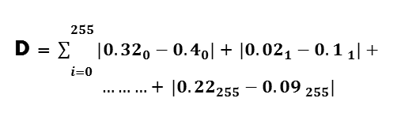
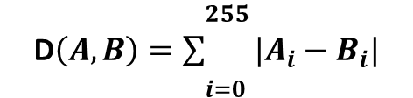
MULTI CENTROID
D$\left(A,B\right)=\sum_{\begin{aligned} \\ i=0\end{aligned}}^{\begin{aligned}255 \\ \end{aligned}}{{|A}_{i}−B_{i}|}$
SET RANDOM K FILES AS CENTROIDS
K=10
COMPUTE MANHATTAN DISTANCE FOR TRAINING FILES & ASSIGN THEM TO THE NEAREST CENTROID
D = $\sum_{\begin{aligned} \\ i=0\end{aligned}}^{\begin{aligned}255 \\ \end{aligned}}{{|0.32}_{0}−{0.4}_{0}|}$+ ${|0.02}_{1}−{0.1 }_{1}|+ ………\text{+ }{|0.22}_{255}−{0.09 }_{255}|$
UPDATE CENTROIDS. REPEAT UNTIL THE CENTROIDS STABILIZE
USE MAHALANOBIS DISTANCE TO COMPUTE DISTANCE AGAINST THE CENTROIDS FOR TEST FILES
K-MEANS
Content Detection and Analysis for Big Data
Notes:
Slides can vary as per your presentation, but header and footer should be consistent

Slide 15
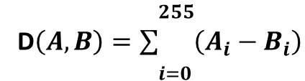
EXEMPLAR FILES AS CENTROIDS
D$\left(A,B\right)=\sum_{\begin{aligned} \\ i=0\end{aligned}}^{\begin{aligned}255 \\ \end{aligned}}{\left(A_{i}−B_{i}\right)}$
HIGHER PRECISION
FOR EACH TEST FILE COMPUTE THE MANHATTAN DISTANCE AGAINST EACH TRAINING FILE OF EACH FILE TYPE. THE FILE TYPE OF THE CLOSEST FILE IS ASSIGNED TO THE TEST FILE
COMPUTATIONALLY EXPENSIVE
Content Detection and Analysis for Big Data
Notes:
Slides can vary as per your presentation, but header and footer should be consistent

Slide 16
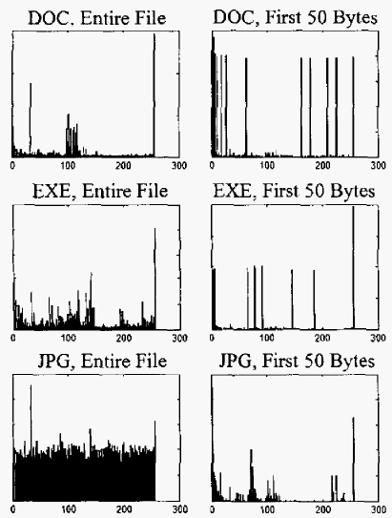


BFD OF ENTIRE FILE AND FIRST 50 BYTES
MOST RELEVANT PART LOCATED EARLY IN THE FILE
TRUNCATION
ANALYSIS PERFORMED ON THE FIRST 20, 200, 500, 1000 BYTE AND THE ENTIRE FILE
REDUCED COMPUTING TIME FOR MODEL BUILDING AND FILE TESTING
Content Detection and Analysis for Big Data
Notes:
Slides can vary as per your presentation, but header and footer should be consistent

Slide 17
PROCESS
ONE CENTROID
MULTI CENTROID
EXEMPLAR FILES AS CENTROID
TRUNCATED DATA
NORMALIZED BFD
TRAINING DATA FOR MODEL GENERATION
SIMILARITY MEASURE
ASSIGN FILETYPE
TEST DATA
Content Detection and Analysis for Big Data
Notes:
Slides can vary as per your presentation, but header and footer should be consistent

Slide 18
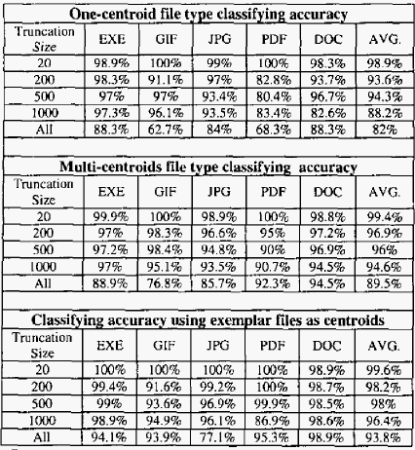
RESULTS
PROBLEMS:
GIF AND JPG ARE SIMILAR
PDF AND DOC (MS OFFICE) FILES MAY CONTAIN IMAGES
PDF MAY BE MISCLASSIFIED TO GIF
AVERAGE ACCURACY OVER 100 TRIALS USING CROSS VALIDATION
FEW MISCLASSIFIED FILES WHEN TRUNCATED FILES ARE USED
Content Detection and Analysis for Big Data
Notes:
Slides can vary as per your presentation, but header and footer should be consistent

Slide 19




CONCLUSION AND FUTURE SCOPE
EVERY FILE TYPE HAS A DISTINCTIVE AVERAGE BFD, WHICH IS THE FILE PRINT
TESTING THE MODEL ON TRAIL TRUNCATED DATASETS
EFFECTIVE TOOL FOR DETECTING SECURITY POLICY VIOLATION AND VIRUS ATTACKS
BIGRAM OR TRIGRAM ANALYSIS TO DIFFERENTIATE BETWEEN MS OFFICE FILE TYPES
Content Detection and Analysis for Big Data
Notes:
Slides can vary as per your presentation, but header and footer should be consistent

Slide 20
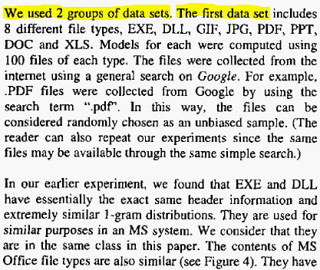
PROS & CONS
SIMPLICITY OF THE TECHNIQUE USED
TYPOS AND MISSING IMPLEMENTATION DETAILS
OPEN SOURCE DATA ALLOWS OTHERS TO RECREATE THE ENTIRE EXPERIMENT
CONTENT DETECTION RELIES ON HEADER INFORMATION
ENABLES REAL TIME NETWORK BASED DETECTORS DUE TO TRUNCATION
Content Detection and Analysis for Big Data
Notes:
Slides can vary as per your presentation, but header and footer should be consistent

Slide 21

COMBINED APPROACH
CHARACTER ENCODING
GLOB
CONTENT TYPE
OTHER
MAGIC BYTES
Content Detection and Analysis for Big Data
Notes:
Slides can vary as per your presentation, but header and footer should be consistent

Slide 22
THANK YOU
Content Detection and Analysis for Big Data
Notes:
Slides can vary as per your presentation, but header and footer should be consistent

